Slide 1
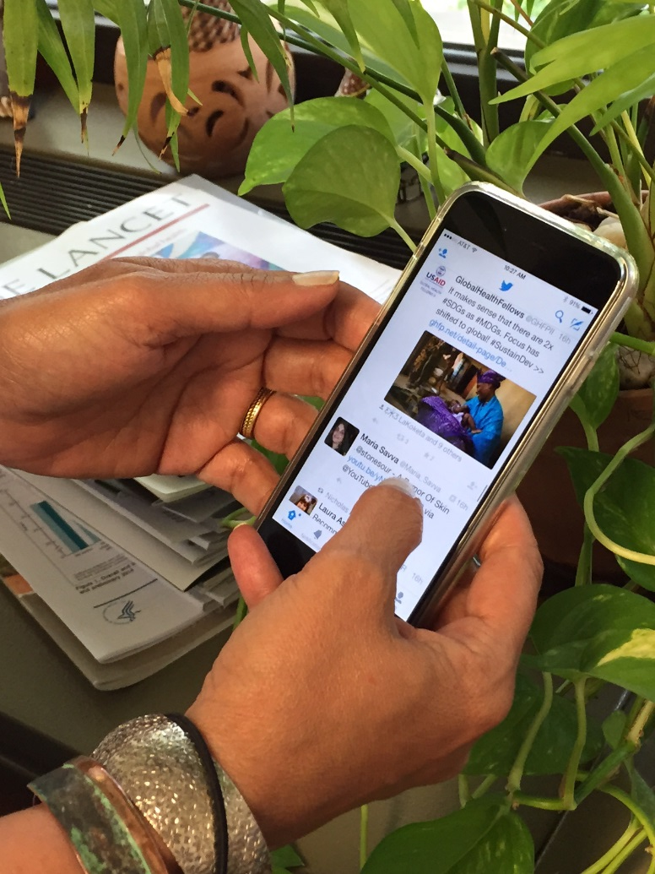
World Birth Defects Day 3 March 2018
#WorldBDDay

Slide 2
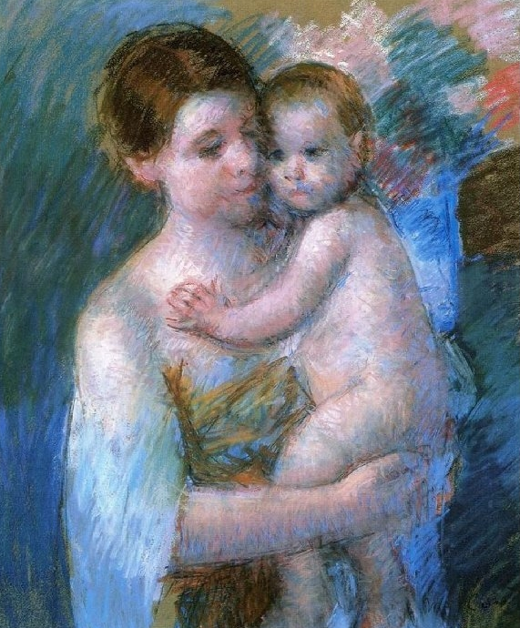
On 3 March 2018, several worldwide organizations will mark the fourth annual World Birth Defects Day.
Mary Cassat:Mother and son (1900)

Slide 3
Birth Defects
Birth defects, also named congenital anomalies, are structural or functional anomalies due to prenatally determined developmental anomalies that can be identified prenatally, at birth, or sometimes may only be detected later in infancy.
Examples of birth defects
Structural
Heart Defects, Spina Bifida, Hypospadias, Limb Deficiency, Club Foot, Down Syndrome
Functional
Metabolic Diseases, Hearing Loss, Thalassemia, Cystic Fibrosis, Autism Spectrum Disorders

Slide 4
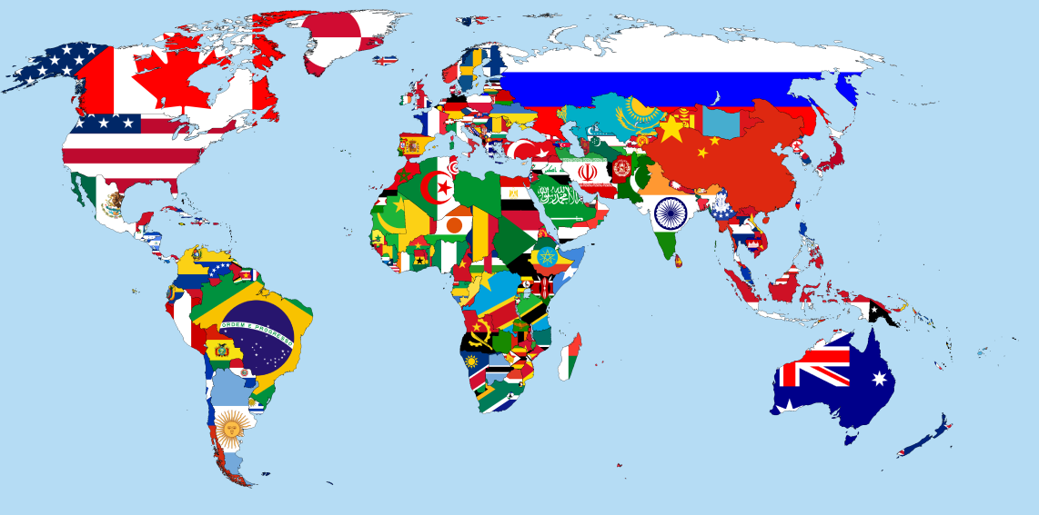
Frequency and Diagnosis
Birth defects are common, costly, and critical.
Every year it is estimated that approximately 133 million babies are born around the world, more than 8 million of them (1 in 16) are born with a serious birth defect.
Several structural birth defects are detected before or soon after birth, functional birth defects are more often diagnosed during the first years of life.

Slide 5
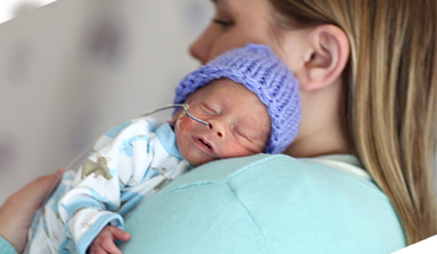
Burden
In many countries birth defects are one of the leading causes of death in infants and young children.
Babies who survive may have a good quality of life with appropriate treatment or care, however many infants are at an increased risk for long-term disabilities.
Their quality of life matters!

Slide 6
Causes and Prevention
Although approximately 50% of all birth defects cannot be linked to a specific cause, there are some known causes or risk factors.
Non-genetic known causes or risk factors can be mitigated or removed before conception or early pregnancy to prevent some birth defects.
Examples: insufficient folate status, badly treated diabetes, obesity, lack of protection against infectious diseases, some teratogenic medications, smoking, alcohol.

Slide 7
The Goal
The main goal of the day is to use our collective social media voice to reach more people with news and messages from around the world.
We hope this will spur more efforts to expand birth defects surveillance, prevention, care, and research worldwide.

Slide 8
Become a 2018 World Birth Defects Day Participating Organization Application form available at http://www.worldbirthdefectsday.org/

Slide 9
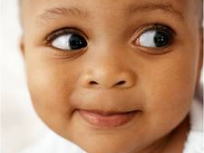
What can you do to observe the Day?
Organize an event
Follow news and advices on www.worldbirthdefectsday.org
Add your voice with social media or events to raise awareness.
Register with your social media accounts to join Thunderclap
Join the Buzzday on Twitter using the hashtag #WorldBDDay

Slide 10
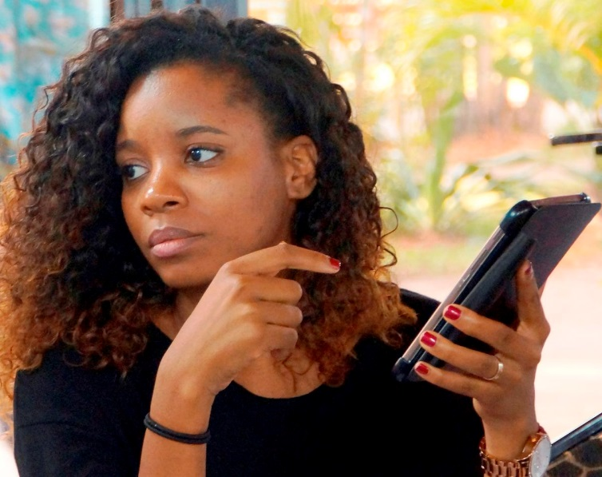
Your energy is greatly needed!
Tweet, retweet, share and comment. Make noise!
It will increase the reach of worldwide messages and expand awareness.
© 2014 Arturo Sanabria, Courtesy of Photoshare

Slide 11
Stay Tuned. More to come.

Slide 12
Use this presentation as you like Translate if needed

