Slide 1
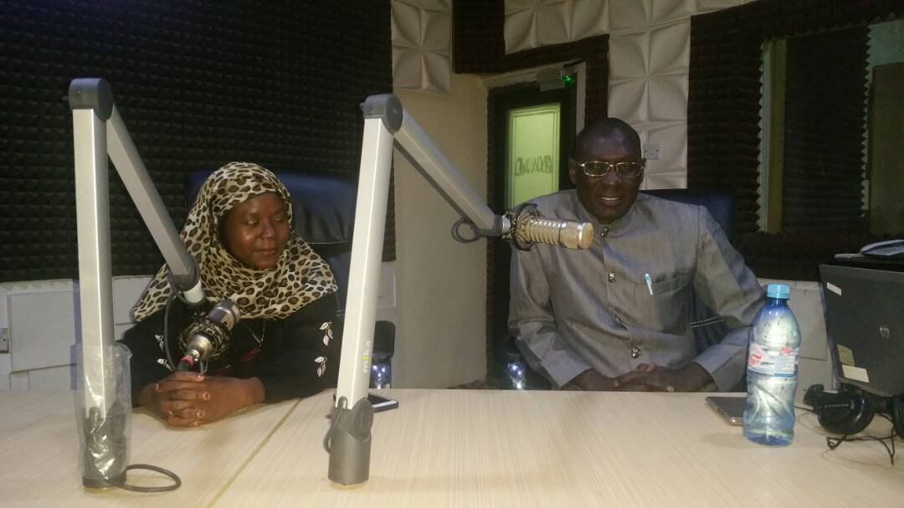
Activity in Kano, Nigeria
Radio discussion and phone in program at Dala FM
The program generated
great interest
Moreover,
the Chief Medical Director of
Aminu Kano Teaching Hospital,
approved a
Registry for Congenital Anomalies
the first of its kind in Northern Nigeria.
Dr. Labaran hope it serve as a model for other hospitals and provide a platform for documentation and research in this field.
Kano, North Nigeria
Dr Aliyu Labaran Dayyabu
(MBBS, FWACS, MSc Obst & Gyne Ultrasound)
and
Dr Zubaida Faruk(Consultant Paediatrician).
Event Promoted by:
Dr Aliyu Labaran Dayyabu
(MBBS, FWACS, MSc Obst & Gyne Ultrasound). Senior Lecturer Bayero University Kano & Consultant Obstetrician and Gynaecologist at Aminu Kano Teaching Hospital O & G Dept Feto-Maternal Medicine Unit. Director Ian Donald School Nigeria Branch. President African Perinatal Society.

