Slide 1
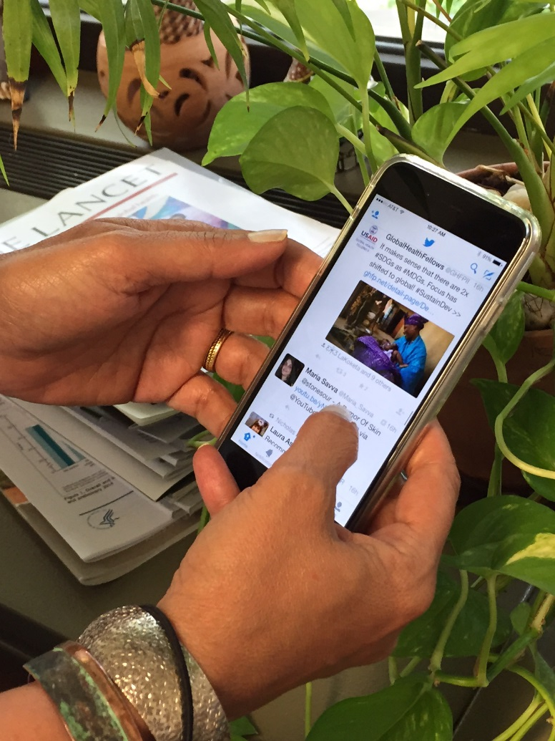
World Birth Defects Day – March 3, 2019
#WorldBDDay

Slide 2
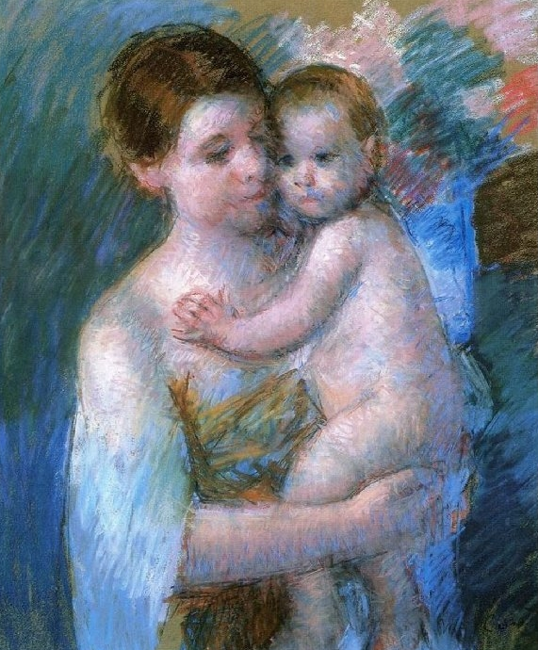
On March 3rd 2019, several worldwide organizations will mark the fifth annual World Birth Defects Day.
Mary Cassat:Mother and son (1900)

Slide 3
Birth Defects
Birth defects, also named congenital anomalies, are structural or functional anomalies due to prenatally determined developmental anomalies that can be identified prenatally, at birth, or sometimes may only be detected later in infancy.
Examples of birth defects
Structural
Heart Defects, Spina Bifida, Hypospadias, Limb Deficiency, Club Foot, Down Syndrome.
Functional
Metabolic Diseases, Hearing Loss, Thalassemia, Cystic Fibrosis, Autism Spectrum Disorders.
The focus of World Birth Defects Day is on structural birth defects, since many functional anomalies have other awareness days.

Slide 4
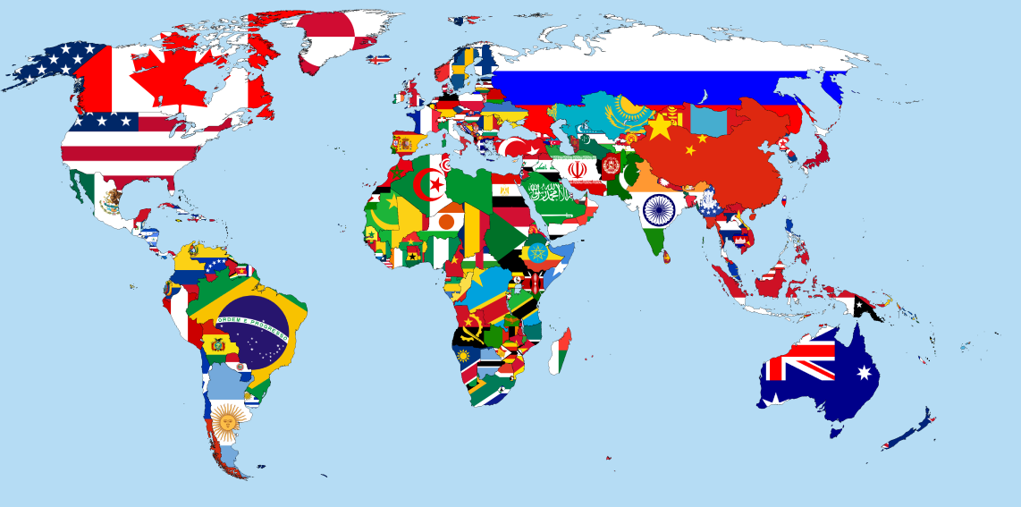
Frequency
Structural birth defects are common, costly, and critical.
Every year it is estimated that approximately 133 million babies are born around the world, approximately 4 million of them (1 in 33) are born with a serious structural birth defect.

Slide 5
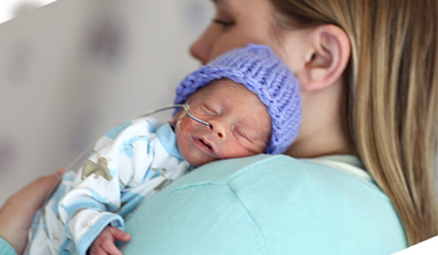
Burden
In many countries birth defects are one of the leading causes of death in infants and young children.
Babies who survive may have a good quality of life with appropriate treatment or care, however many infants are at an increased risk for long-term disabilities.
Their quality of life matters!

Slide 6
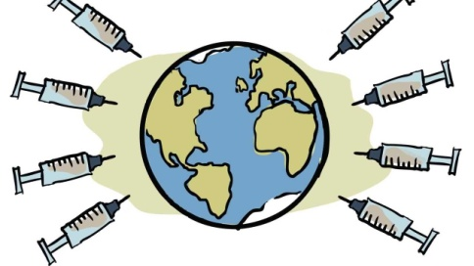
Causes and Prevention
Although approximately 50% of structural birth defects cannot be linked to a specific cause, there are some known causes or risk factors.
Non-genetic known causes or risk factors can be mitigated or removed before conception or early pregnancy to prevent some birth defects.
Examples: insufficient folate status, badly treated diabetes, obesity, lack of protection against infectious diseases, some teratogenic medications, smoking, alcohol.

Slide 7
The Goal
The main goal of the day is to use our collective voice to reach more people with news, messages and fact sheets.
We hope this will spur more efforts
to expand birth defects
surveillance, prevention, care, and research
worldwide.

Slide 8
Become a 2019 Recognized World Birth Defects Day Partner Organization
Application form available at: https://www.worldbirthdefectsday.org/
Increase YOUR visibility

Slide 9
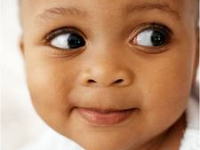
What can you do to observe the Day?
Organize a meeting to increase knowledge on birth defects prevention and care.
Add your voice with social media to raise awareness.
Register with your social media account to join Thunderclap.
Join the Buzzday on Twitter using the hashtag #WorldBDDay.
Encourage other organizations to join the WBDD movement.
Follow news and advices on https://www.worldbirthdefectsday.org/

Slide 10
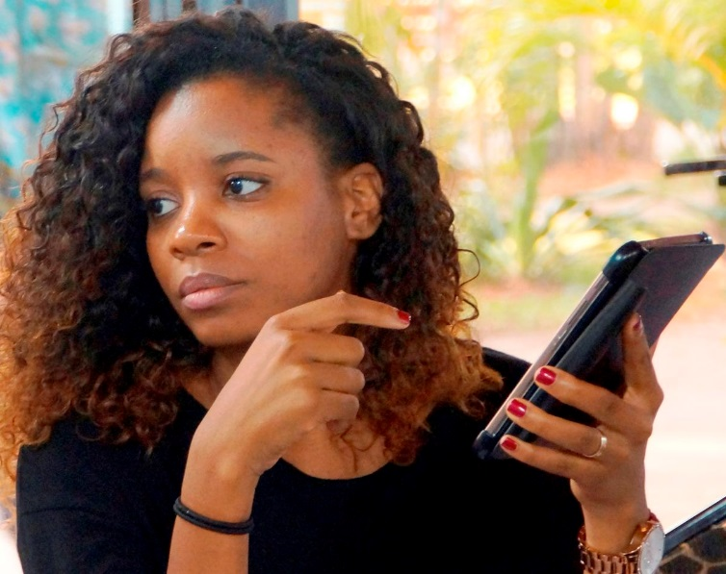
Your energy is greatly needed!
Tweet, retweet, share and comment. Make noise!
It will increase the reach of worldwide messages and expand knowledge and awareness.

Slide 11
Stay Tuned. More to Come.

Slide 12
Use this presentation as you like Translate if needed

