Slide 1


Sunday, March 3rd is:
World Birth Defects Day
2024 WBDD Social Media Toolkit

Slide 2

WBDD24 Toolkit Table of Contents
Why a World Birth Defects Day?
WBDD 8 Second Challenge
WBDD 2024 #hashtags
Key Messaging
Suggested Activities
Share your story
WBDD 2024 Significant Dates
WBDD Resources
WBDD Social Media channels
We provide a list of ideas and activities that can be done individually or with partners and organizations. We invite you to use this toolkit to design relevant content that is meaningful for your audiences and communities.

Slide 3
Why World Birth Defects Day?
World Birth Defects Day (WBDD) was first observed on March 3rd, 2015. Each year WBDD unites people and organizations to spread awareness around prevention, treatment, and care for those with birth defects.
WBDD aims to use a collective voice in raising awareness for all birth defects and improve prevention, care, and treatment. This 2024 World Birth Defects Day Toolkit has been developed to help you plan your awareness campaign.

Slide 4
WBDD 8 Second Challenge
“Every year, around 8 million children are born with birth defects globally. Let’s take 8 seconds to raise awareness for the 8 million affected by birth defects.”
Download and print the 8 Second challenge sign – English | Spanish
Set up your camera, hold up the 8 Second Challenge sign, and hit record!
  State your name and country of residence if comfortable.
  In 8 seconds, describe a fact about a birth defect you care about. (i.e. What is the birth defects? How does this birth defect affect daily life/functions? How has this birth defected impacted you?)
  After the 8 seconds are up, nominate someone within your social network to complete the 8 Second Challenge with a birth defect they care about. (i.e. family, friends, co-workers, local decision makers, influential people).
Once you have a video, upload it to Instagram Reels, Facebook, and X (Twitter) then tag @worldbdday (Instagram and X) / @WBDday (Facebook) and use #WorldBDday and #WBDD8SecChallenge. Spread the word and happy recording!
Tip: 8 seconds goes by quick! Keep it brief and insightful. If you can’t complete the challenge in 8 seconds don’t worry! The main purpose is to promote awareness, learn about birth defects, and spread the word!

Slide 5
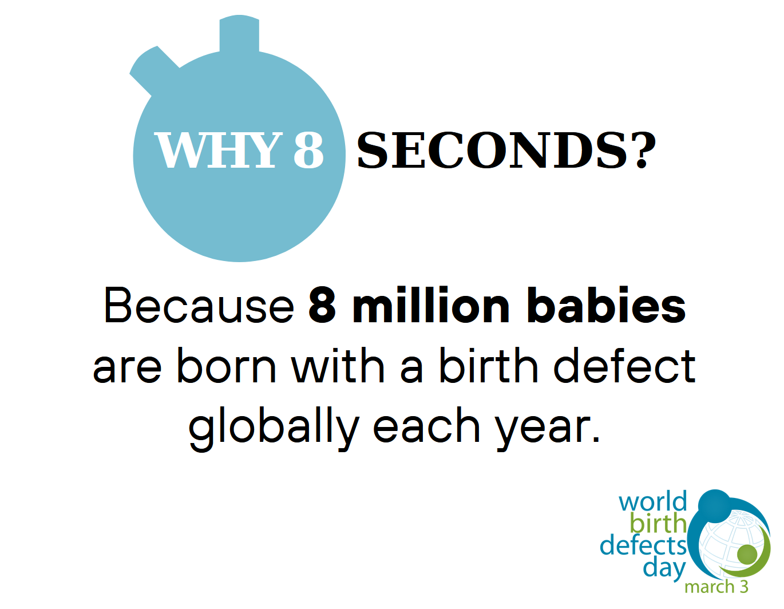
WBDD 2024 Challenge Sign
Download the sign! – English/Spanish

Slide 6
WBDD 2024 #hashtags
This year, WBDD will be using #EveryJourneyMatters and #AwarenessWithoutStigma as a reminder that while “birth defect” is a medical term, it doesn’t mean that an individual is “defective”. Instead, it refers to health conditions that develop in a baby before birth.
Be sure to tag @worldBDday (Instagram & X) / @WBDday (Facebook) and include #WorldBDday #EveryJourneyMatters and #AwarenessWithoutStigma in your description!
Notes:
The 2024 WBDD (#WorldBDDay) theme is “Every Journey Matters.” Birth defects affect individuals, family, friends, and communities. That’s why #EveryJourneyMatters.
While “birth defect” is a medical term, it doesn’t mean that an individual is “defective.” Instead, it refers to health conditions that develop in a baby before birth that affects the structure or function of their body. Join us on March 3rd for #WorldBDDay to raise one voice across the globe for birth defect awareness.

Slide 7
Key Messaging
  More than 8 million babies worldwide are born with a serious birth defect each year. Birth defects cause 1 out of every 5 deaths in infants and lead to lifelong disabilities and challenges for those who do survive. Today, we join other organizations in one voice to raise awareness about birth defects. Learn more at: www.worldbirthdefectsday.org #WorldBDDay #EveryJourneyMatters #AwarenessWithoutStigma
  Many birth defects can be prevented and treated. Help raise awareness about birth defect prevention on March 3rd for World Birth Defects Day! Learn more at: www.worldbirthdefectsday.org #WorldBDDay #EveryJourneyMatters #AwarenessWithoutStigma
Feel free to adapt, use, and share the example messages listed above and use
#WorldBDDay #EveryJourneyMatters #AwarenessWithoutStigma

Slide 8
Key Messaging cont.
  Birth defects are thought to be caused by a complex mix of genes, behaviors and environment. Although not all birth defects can be prevented, you can increase your chances of having a healthy baby by taking a folic acid containing multivitamin, managing health conditions, and adopting healthy behaviors before becoming pregnant. #WorldBDDay #EveryJourneyMatters #AwarenessWithoutStigma
  There are thousands of different birth defects, and 70% of the causes are unknown. Common birth defects include heart defects, orofacial clefts, Down syndrome and spina bifida. Some birth defects are on the rise for unknown reasons – like gastroschisis. #WorldBDDay #EveryJourneyMatters #AwarenessWithoutStigma
Feel free to adapt, use, and share the example messages listed above and use
#WorldBDDay #EveryJourneyMatters #AwarenessWithoutStigma

Slide 9
Key Messaging cont.
  While “birth defect” is a medical term, it doesn’t mean that an individual is “defective.” Instead, it refers to health conditions that develop in a baby before birth. Partner with us on March 3rd in raising #AwarenessWithout Stigma about birth defects. Learn more at: www.worldbirthdefectsday.org.
  Birth defects affect individuals, family, friends, and communities. That’s why #EveryJourneyMatters. Join us on March 3rd for #WorldBDDay to raise one voice across the globe for birth defect awareness. Learn more at: www.worldbirthdefectsday.org.
Feel free to adapt, use, and share the example messages listed above and use
#WorldBDDay #EveryJourneyMatters #AwarenessWithoutStigma

Slide 10
Suggested Activities
  Be active on social media! Use #WorldBDDay #EveryJourneyMatters and #AwarenessWithoutStigma.
  Publicize World Birth Defects Day on your organization’s website.
  Add the World Birth Defect Day logo and hashtag in your email signature.
  Organize an event to celebrate World Birth Defect Day.
  Disseminate information about your organization’s activities in support of World Birth Defect Day.

Slide 11
Share your Story
Birth defects can occur in any family. Help us create a more inclusive and comfortable world for those with birth defects. Share a post, photo, or video documenting your experience to help support others around the worldwide. You can view stories at:
https://www.worldbirthdefectsday.org/category/engagement/stories/
Please email your story to centre@icbdsr.org and worldbdday@gmail.com

Slide 12
WBDD 24 Significant Dates
  Live Chat on X (formerly Twitter) and Instagram Threads – Friday, March 1rd @11:00 am EST
  World Birth Defects Day – Sunday, March 3rd
  MotherToBaby Online Webinar – Friday, March 1st @ 1:00 pm EST
  WHO Webinar – Monday, March 4th at 8:00 AM EST

Slide 13
WBDD24 Resources
World Birth Defects Day Logo - English/Spanish
WBDD24 Banner - English/Spanish
WBDD24 Flyer - English/Spanish
WBDD24 Resource Guide - English/Spanish
WBDD 8 Seconds Challenge Instructions – English/Spanish
WBDD 8 Seconds Challenge Sign - English/Spanish

Slide 14



WBDD Social Media
To engage with the WBDD24 campaign, remember to follow all of our socials! We will publish messages, key events and our partnership activities.
Social Channels:
Hashtags:
#WorldBDday
#EveryJourneyMatters
#AwarenessWithoutStigma
@worldBDday
@WBDday
@worldBDday

Slide 15
Thank you for being part of
World Birth Defects Day 2024
For more information, please contact us at:
centre@icbdsr.org and worldbdday@gmail.com

