Slide 1
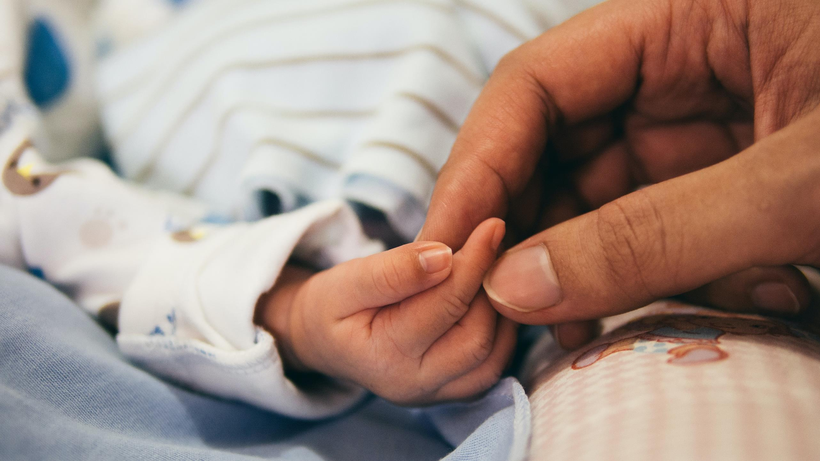

Sunday, March 3rd is:
World Birth Defects Day
2026 WBDD Social Media Toolkit

Slide 2
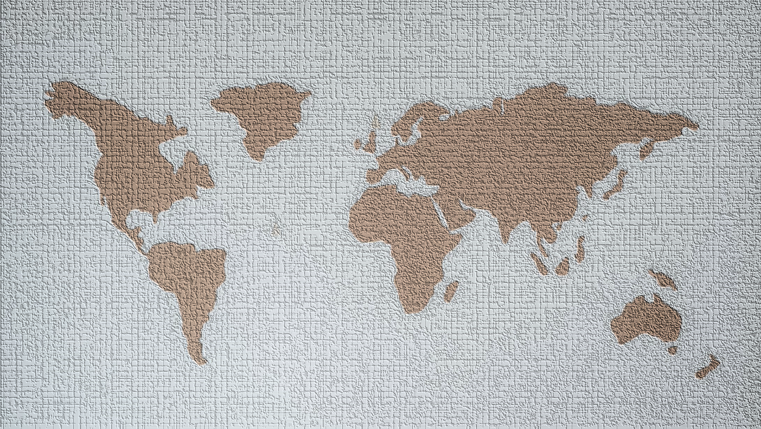
WBDD26 Toolkit Table of Contents
Why a World Birth Defects Day?
WBDD personal challenge to raise awareness about birth defects
WBDD 2026 #hashtags
Key Messaging
Suggested Activities
Share your story
WBDD 2026 Significant Dates
WBDD Resources
WBDD Social Media channels
We provide a list of ideas and activities that can be done individually or with partners and organizations. We invite you to use this toolkit to design relevant content that is meaningful for your audiences and communities.

Slide 3
Why World Birth Defects Day?
World Birth Defects Day (WBDD) was first observed on March 3rd, 2015. Each year WBDD unites people and organizations to spread awareness around prevention, treatment, and care for those with birth defects.
WBDD aims to use a collective voice in raising awareness for all birth defects and improve prevention, care, and treatment. This 2026 World Birth Defects Day Toolkit has been developed to help you plan your awareness campaign.

Slide 4
WBDD Personal Challenge
“Add Yours” IG Story Feature
•Create “Add Yours” sticker on @WorldBDDay Instagram account + post a story; partners/other individuals can then use the same template.
•People will be able to respond to the prompt without printing a paper/writing (replaces our paper “selfies” engagement). They can use text feature on IG story. We can keep “birth defects matter to me” or change it. Can be added to “highlights” to give a permanent place on IG account. Additional details will be forthcoming.

Slide 5
WBDD 2026 #hashtags
This year, WBDD will be using #EveryJourneyMatters and #AwarenessWithoutStigma as a reminder that while “birth defect” is a medical term, it doesn’t mean that an individual is “defective”. Instead, it refers to health conditions that develop in a baby before birth.
Be sure to tag @worldBDday (Instagram & X) / @WBDday (Facebook) and include #WorldBDday #EveryJourneyMatters and #AwarenessWithoutStigma in your description!
Notes:
The 2026 WBDD (#WorldBDDay) theme is “Every Journey Matters.” Birth defects affect individuals, family, friends, and communities. That’s why #EveryJourneyMatters.
While “birth defect” is a medical term, it doesn’t mean that an individual is “defective.” Instead, it refers to health conditions that develop in a baby before birth that affects the structure or function of their body. Join us on March 3rd for #WorldBDDay to raise one voice across the globe for birth defect awareness.

Slide 6
Key Messaging
  More than 8 million babies worldwide are born with a serious birth defect each year. Birth defects cause 1 out of every 5 deaths in infants and lead to lifelong disabilities and challenges for those who do survive. Today, we join other organizations in one voice to raise awareness about birth defects. Learn more at: www.worldbirthdefectsday.org #WorldBDDay #EveryJourneyMatters #AwarenessWithoutStigma
  Many birth defects can be prevented and treated. Help raise awareness about birth defect prevention on March 3rd for World Birth Defects Day! Learn more at: www.worldbirthdefectsday.org #WorldBDDay #EveryJourneyMatters #AwarenessWithoutStigma
Feel free to adapt, use, and share the example messages listed above and use
#WorldBDDay #EveryJourneyMatters #AwarenessWithoutStigma

Slide 7
Key Messaging cont.
  Birth defects are caused by a complex mix of genes, behaviors and environment. Although not all birth defects can be prevented, you can increase your chances of having a healthy baby by taking a folic acid containing multivitamin, managing health conditions, and adopting healthy behaviors before becoming pregnant. #WorldBDDay #EveryJourneyMatters #AwarenessWithoutStigma
  There are thousands of different birth defects, and most of the causes of birth defects are unknown. Common birth defects include heart defects, orofacial clefts, Down syndrome and spina bifida. #WorldBDDay #EveryJourneyMatters #AwarenessWithoutStigma
Feel free to adapt, use, and share the example messages listed above and use
#WorldBDDay #EveryJourneyMatters #AwarenessWithoutStigma

Slide 8
Key Messaging cont.
  While “birth defect” is a medical term, it doesn’t mean that an individual is “defective.” Instead, it refers to health conditions that develop in a baby before birth. Partner with us on March 3rd in raising #AwarenessWithout Stigma about birth defects. Learn more at: www.worldbirthdefectsday.org.
  Birth defects affect individuals, family, friends, and communities. That’s why #EveryJourneyMatters. Join us on March 3rd for #WorldBDDay to raise one voice across the globe for birth defect awareness. Learn more at: www.worldbirthdefectsday.org.
Feel free to adapt, use, and share the example messages listed above and use
#WorldBDDay #EveryJourneyMatters #AwarenessWithoutStigma

Slide 9
Suggested Activities
  Be active on social media! Use #WorldBDDay #EveryJourneyMatters and #AwarenessWithoutStigma.
  Publicize World Birth Defects Day on your organization’s website.
  Add the World Birth Defect Day logo and hashtag in your email signature.
  Participate in “Add Yours” sticker on @WorldBDDay Instagram
  Disseminate information about your organization’s activities in support of World Birth Defect Day.

Slide 10
Share your Story
Birth defects can occur in any family. Help us create a more inclusive and comfortable world for those with birth defects. Share a post, photo, or video documenting your experience to help support others around the worldwide. You can view stories at:
https://www.worldbirthdefectsday.org/category/engagement/stories/
Please email your story to centre@icbdsr.org and worldbdday@gmail.com

Slide 11
WBDD26 Resources
World Birth Defects Day Logo - English/Spanish
WBDD26 Resource Guide - English/Spanish
WBDD Personal Challenge Instructions – English/Spanish
https://www.worldbirthdefectsday.org/

Slide 12



WBDD Social Media
To engage with the WBDD26 campaign, remember to follow all of our socials! We will publish messages, key events and our partnership activities.
Social Channels:
Hashtags:
#WorldBDday
#EveryJourneyMatters
#AwarenessWithoutStigma
@worldBDday
@WBDday
@worldBDday

Slide 13
Thank you for being part of
World Birth Defects Day 2026
For more information, please contact us at:
centre@icbdsr.org and worldbdday@gmail.com

